Slide 1

ADVANCED COMPUTER SYSTEM & ARCHITECTURE
Fundamentals of Quantitative Design and Analysis
Assoc Prof Mohd Shahizan Othman

Slide 2
Computer Technology
Performance improvements:
Improvements in semiconductor technology
Feature size, clock speed
Improvements in computer architectures
Enabled by HLL compilers, UNIX
Lead to RISC architectures
Together have enabled:
Lightweight computers
Productivity-based managed/interpreted programming languages

Slide 3
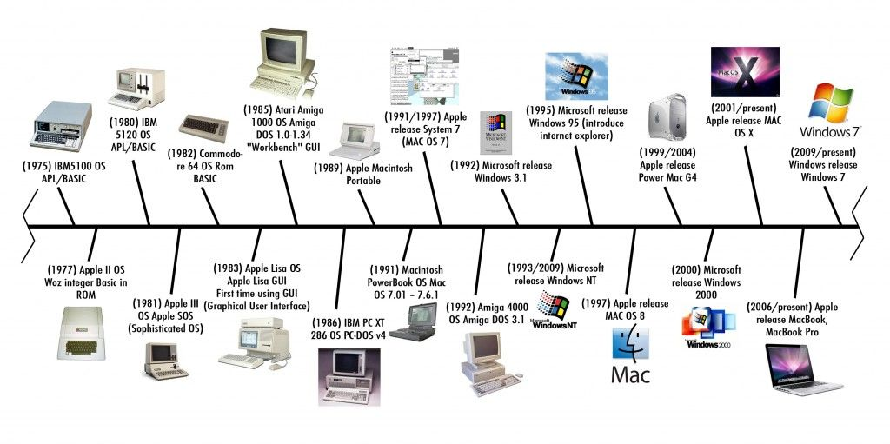
History of Computer Technology

Slide 4
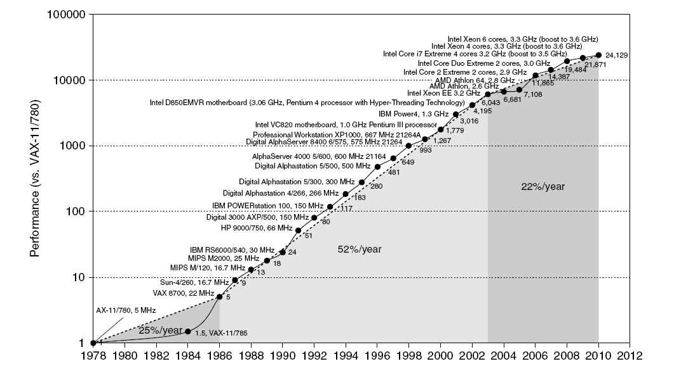
Historical Microprocessor Performance
Source: H&P textbook

Slide 5
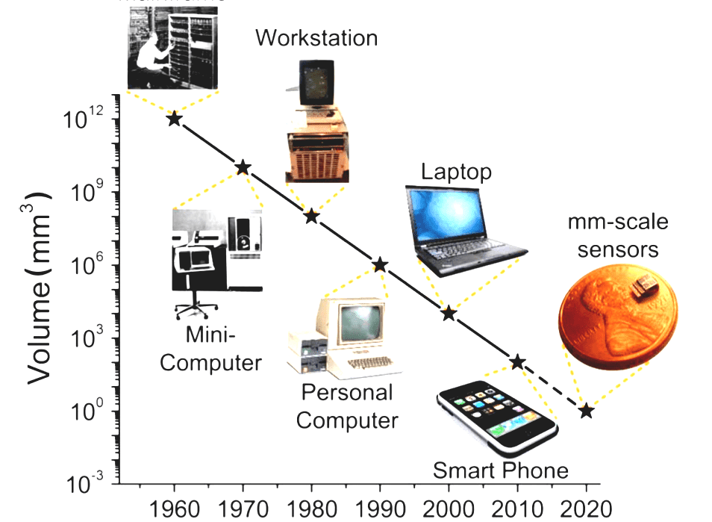
Classes of Computers
Personal Mobile Device (PMD)
e.g. start phones, tablet computers
Emphasis on energy efficiency and real-time
Desktop Computing
Emphasis on price-performance
Servers
Emphasis on availability, scalability, throughput
Clusters / Warehouse Scale Computers
Used for “Software as a Service (SaaS)”
Emphasis on availability and price-performance
Sub-class: Supercomputers, emphasis: floating-point performance and fast internal networks
Internet of Things/Embedded Computers
Emphasis: price

Slide 6
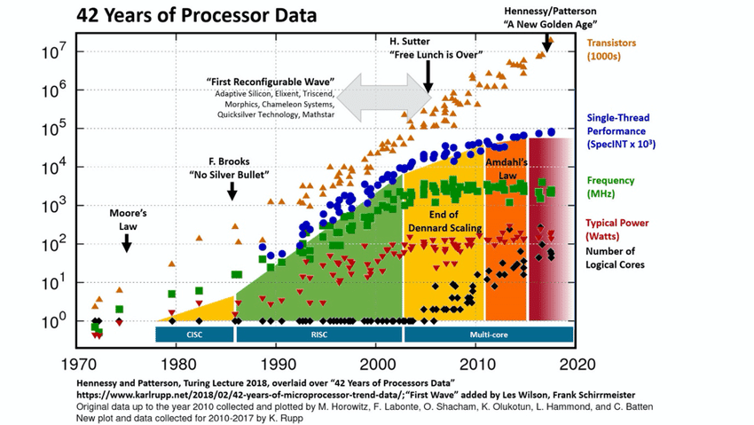

Slide 7
Processor Technology Trends
Transistor density increases by 35% per year and die size
increases by 10-20% per year… more functionality
Transistor speed improves linearly with size (complex
equation involving voltages, resistances, capacitances)
Wire delays do not scale down at the same rate as logic delays
The power wall: it is not possible to consistently run at
higher frequencies without hitting power/thermal limits;
fancy cooling required beyond ~150W

Slide 8
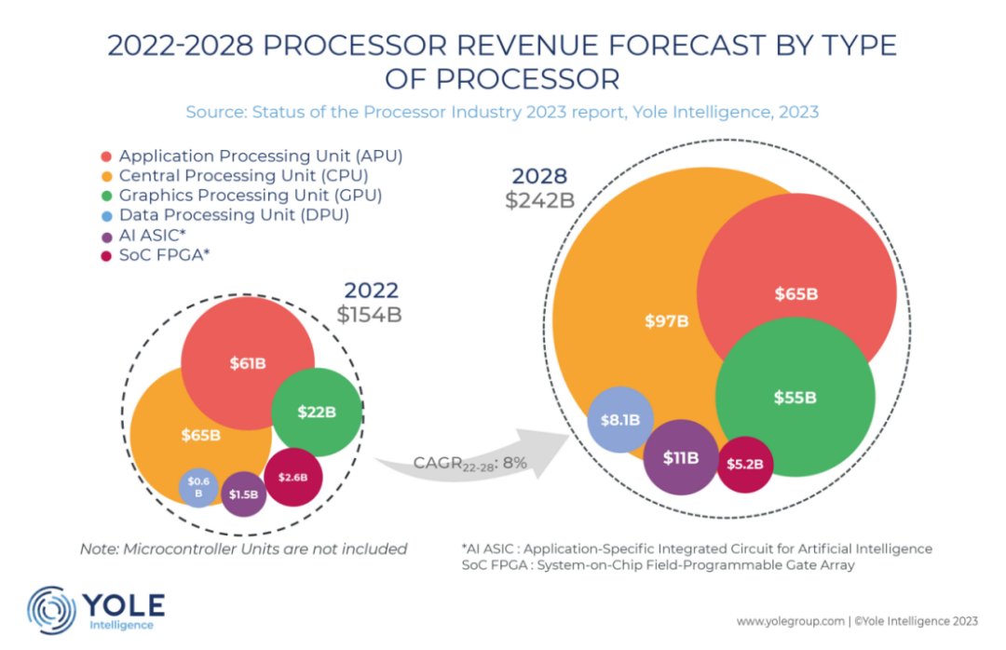

Slide 9
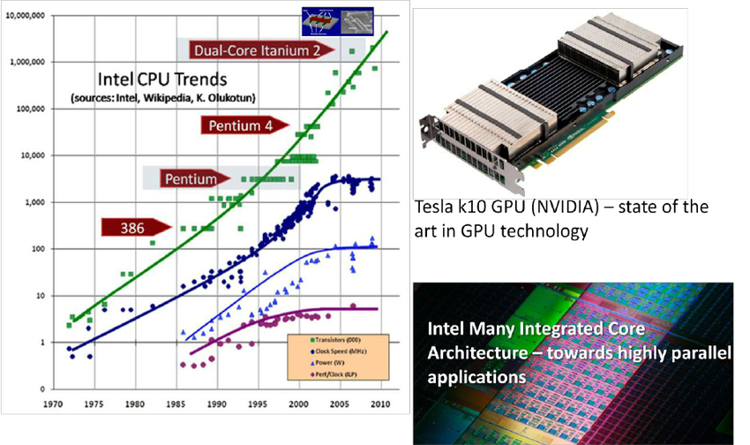

Slide 10
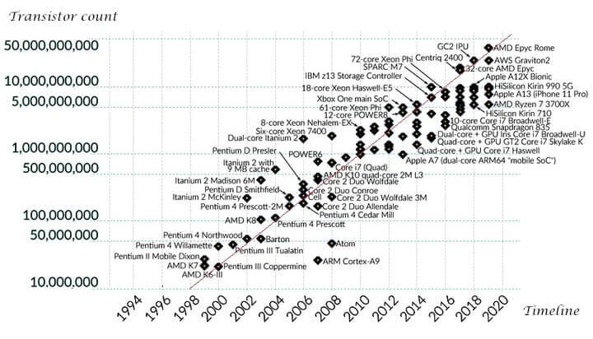
Trends in Transistor Count within CPU

Slide 11
What Helps Performance?
In a clock cycle, can do more work -- since transistors are
faster, transistors are more energy-efficient, and there’s
more of them
Better architectures: finding more parallelism in one thread,
better branch prediction, better cache policies, better
memory organizations, more thread-level parallelism,
moving computations to memory, accelerating some kernels, …

Slide 12
Points to Note
The 52% growth per year is because of faster clock speeds
and architectural innovations (led to 25x higher speed)
Clock speed increases have dropped to 1% per year in
recent years
The 22% growth includes the parallelization from multiple
cores
Moore’s Law: transistors on a chip double every 18-24 months

Slide 13
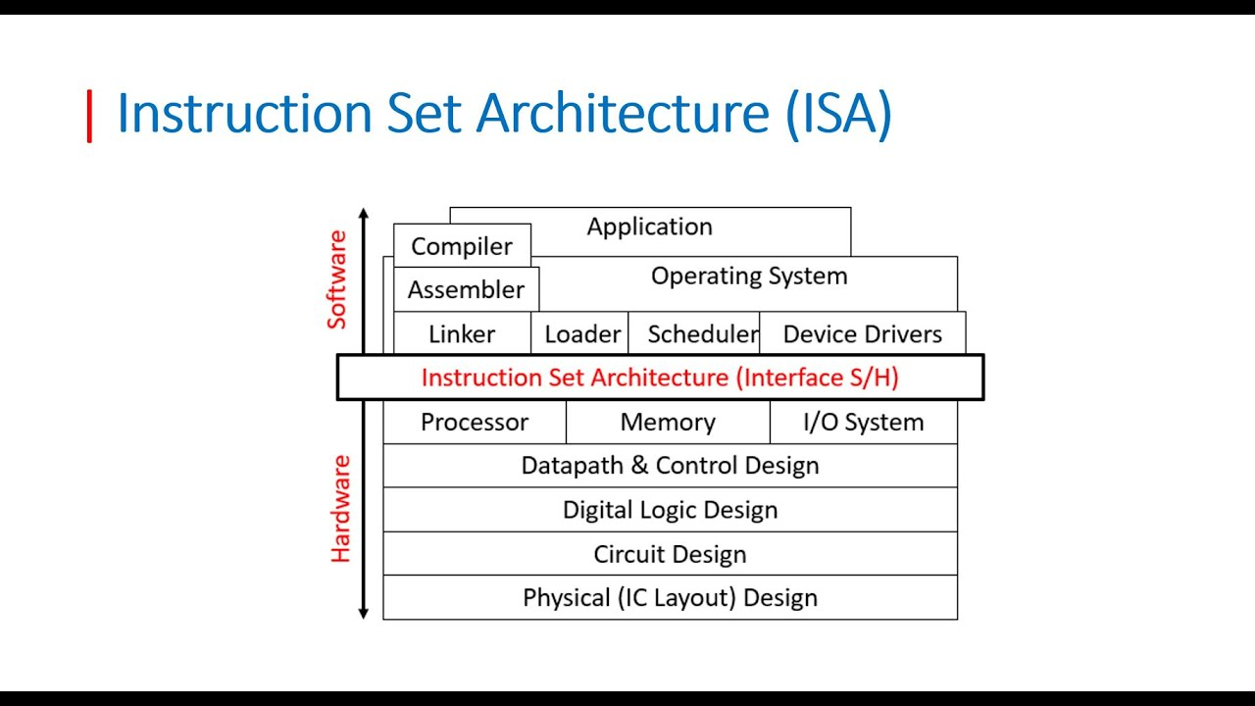
Defining Computer Architecture
“Old” view of computer architecture:
Instruction Set Architecture (ISA) design
i.e. decisions regarding:
registers, memory addressing, addressing modes, instruction operands, available operations, control flow instructions, instruction encoding
“Real” computer architecture:
Specific requirements of the target machine
Design to maximize performance within constraints: cost, power, and availability
Includes ISA, microarchitecture, hardware

Slide 14
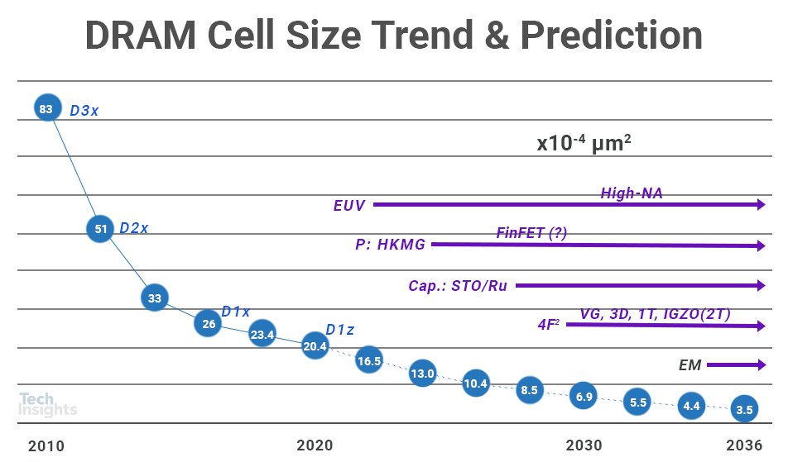
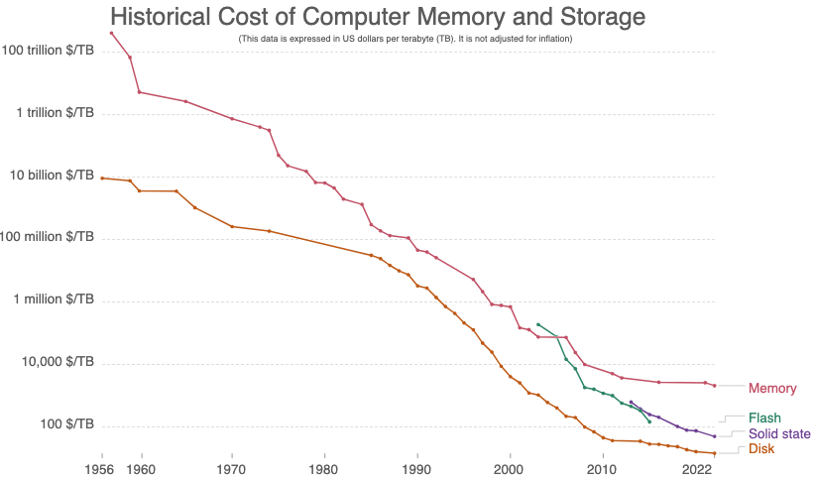
Trends in Technology
Integrated circuit technology (Moore’s Law)
Transistor density: 35%/year
Die size: 10-20%/year
Integration overall: 40-55%/year
DRAM capacity: 25-40%/year (slowing)
8 Gb (2014), 16 Gb (2019), possibly no 32 Gb
Flash capacity: 50-60%/year
8-10X cheaper/bit than DRAM
Magnetic disk capacity: recently slowed to 5%/year
Density increases may no longer be possible, maybe increase from 7 to 9 platters
8-10X cheaper/bit then Flash
200-300X cheaper/bit than DRAM

Slide 15
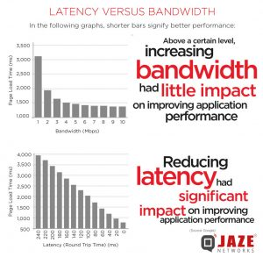
Bandwidth and Latency
Bandwidth or throughput
Total work done in a given time
32,000-40,000X improvement for processors
300-1200X improvement for memory and disks
Latency or response time
Time between start and completion of an event
50-90X improvement for processors
6-8X improvement for memory and disks

Slide 16
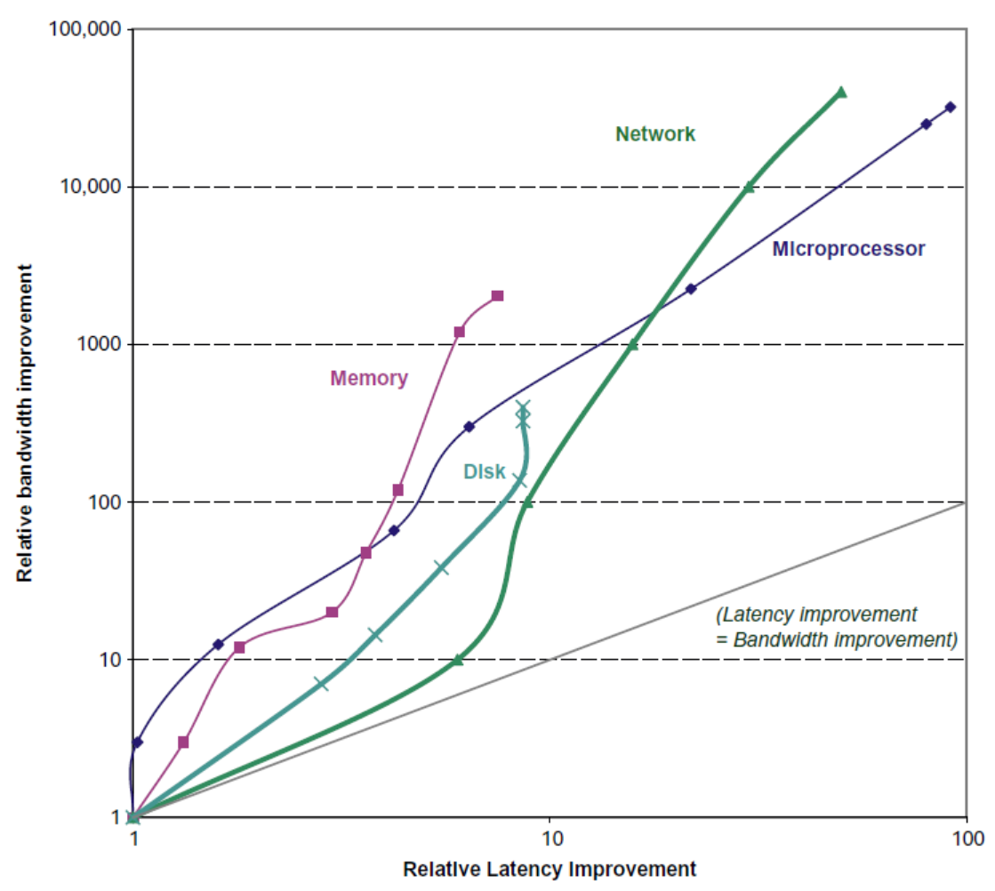
Bandwidth and Latency
Log-log plot of bandwidth and latency milestones
Copyright © 2019, Elsevier Inc. All rights reserved.

Slide 17
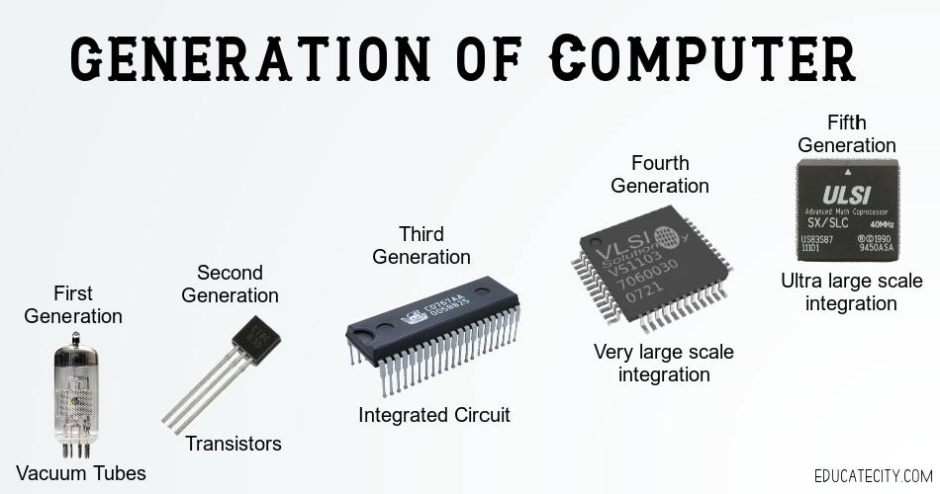
Transistors and Wires
Feature size
Minimum size of transistor or wire in x or y dimension
10 microns in 1971 to .011 microns in 2017
Transistor performance scales linearly
Wire delay does not improve with feature size!
Integration density scales quadratically

Slide 18
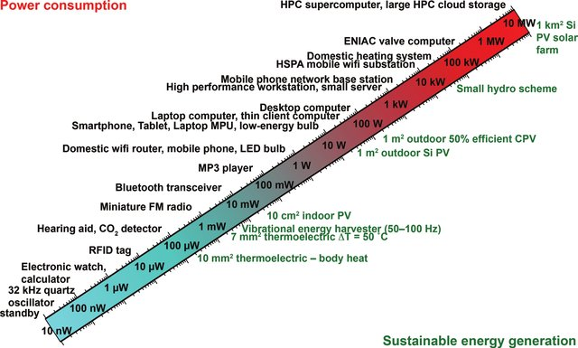
Power and Energy
Problem: Get power in, get power out
Thermal Design Power (TDP)
Characterizes sustained power consumption
Used as target for power supply and cooling system
Lower than peak power (1.5X higher), higher than average power consumption
Clock rate can be reduced dynamically to limit power consumption
Energy per task is often a better measurement

Slide 19
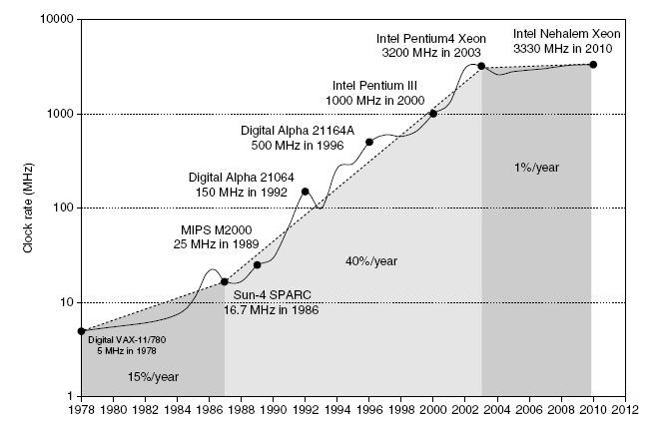
Clock Speed Increases
Source: H&P textbook

Slide 20
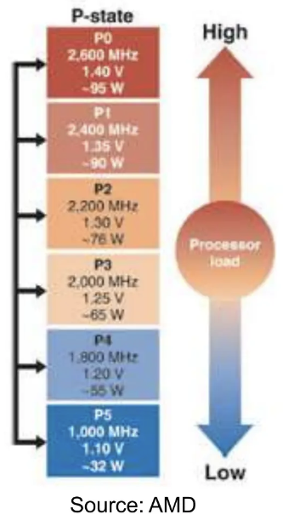
Reducing Power
Techniques for reducing power:
Do nothing well
Dynamic Voltage-Frequency Scaling
e.g, AMD Opteron
Low power state for DRAM, disks
sleep mode
Overclocking, turning off cores
Intel i7, AMD Ryzen

Slide 21
Recent Microprocessor Trends
Transistors: 1.43x / year
Cores: 1.2 - 1.4x
Performance: 1.15x
Frequency: 1.05x
Power: 1.04x
2004
2010
Source: Micron University Symp.

Slide 22
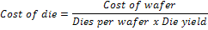
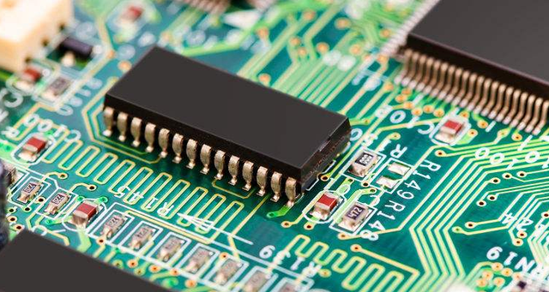
Integrated Circuit Cost
Integrated circuit
Bose-Einstein formula:
Defects per unit area = 0.016-0.057 defects per square cm (2010)
N = process-complexity factor = 11.5-15.5 (40 nm, 2010)

Slide 23



More Diverse Platforms
Image credits: uber, extremetech, anandtech

Slide 24
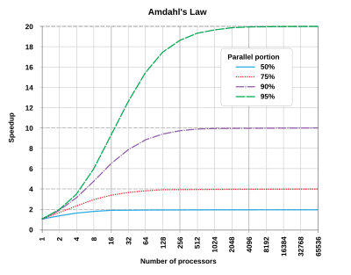
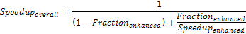
Principles of Computer Design
Take Advantage of Parallelism
e.g. multiple processors, disks, memory banks, pipelining, multiple functional units
Principle of Locality
Reuse of data and instructions
Focus on the Common Case
Amdahl’s Law

Slide 25
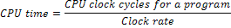
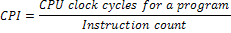
Principles of Computer Design
The Processor Performance Equation

Slide 26
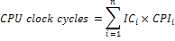
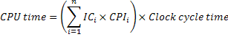
Principles of Computer Design
Different instruction types having different CPIs

Slide 27
Principles of Computer Design
Different instruction types having different CPIs

Slide 28
Fallacies and Pitfalls
All exponential laws must come to an end
Dennard scaling (constant power density)
Stopped by threshold voltage
Disk capacity
30-100% per year to 5% per year
Moore’s Law
Most visible with DRAM capacity
ITRS disbanded
Only four foundries left producing state-of-the-art logic chips
11 nm, 3 nm might be the limit

Slide 29
Fallacies and Pitfalls
Microprocessors are a silver bullet
Performance is now a programmer’s burden
Falling prey to Amdahl’s Law
A single point of failure
Hardware enhancements that increase performance also improve energy efficiency, or are at worst energy neutral
Benchmarks remain valid indefinitely
Compiler optimizations target benchmarks

Slide 30
Where Are We Headed?
Modern trends:
Clock speed improvements are slowing (power constraints)
Difficult to further optimize a single core for performance
Multi-cores: each new processor generation will accommodate more cores
Need better programming models and efficient execution for multi-threaded applications
Need better memory hierarchies
Need greater energy efficiency
Reduced data movement
Emergence of new metrics: security, reliability
Emergence of new workloads: ML, graphs, genomics

